Slide 1
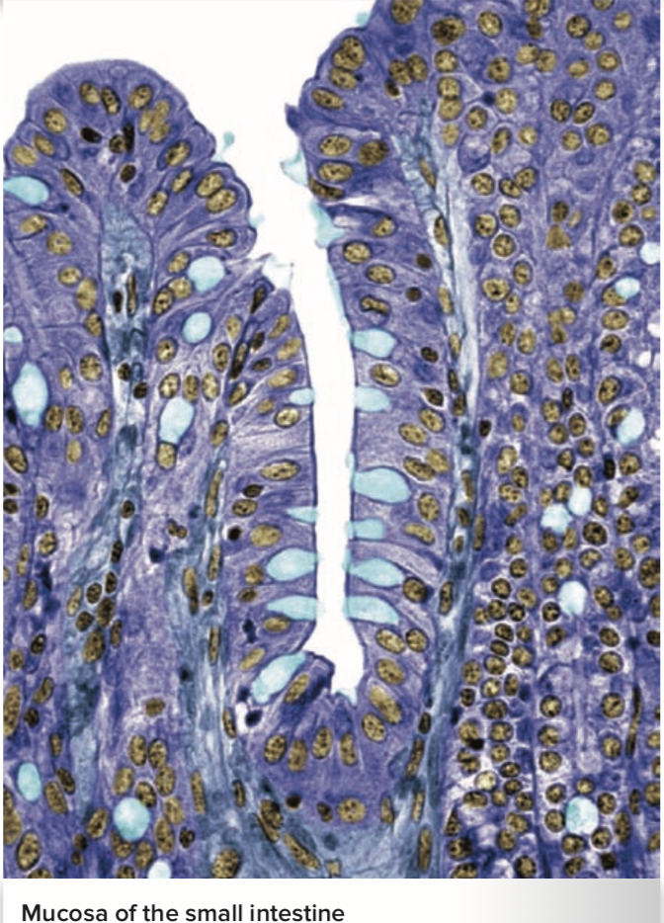
Nutrition & Metabolism
Al-Farabi Kazakh National University
Higher School of Medicine

Slide 2
LEARNING OUTCOMES
define calorie and identify the three primary sources of dietary calories;
define nutrient, identify the six major categories of nutrients, and distinguish between macronutrients and micronutrients;
identify the major forms and sources of dietary carbohydrates;
name some forms of dietary fiber, explain why fiber is important in the diet yet is not a nutrient, and distinguish water-soluble from water-insoluble fiber;
discuss the forms of dietary lipid and explain why lipids are a more efficient means of energy storage than carbohydrates are;
Describe forms of blood lipoproteins and explain their respective functions;
Discuss the body’s protein and amino acid requirements
Describe minerals and vitamins required for the diet.
Al-Farabi Kazakh National University
Higher School of Medicine

Slide 3
Calories
One calorie is the amount of heat that will raise the temperature of 1 g of water 1°C.
The dietary Calories (with a capital C) listed on a food package are actually
-kilocalories (kcal);
-one kilocalorie is 1,000 calories.
-a healthy diet ranges from 2,000 to 2,500 kcal/day.
Adenosine triphosphate (ATP)—the energy carrier necessary for most cellular work.

Slide 4
Nutrients
A nutrient is any ingested chemical that is incorporated into the body’s tissues and used for fuel, growth, repair, or maintenance of the body.
Nutrients fall into six major classes:
water,
carbohydrates,
lipids,
proteins,
minerals,
and vitamins.

Slide 5
Macronutrients:
Water, carbohydrates, lipids, and proteins are considered
Micronutrients:
Minerals and vitamins are called so because of its small quantities.

Slide 6
Nutrient | Daily Requirement | Representative Functions
Water | 2.7–3.7 L | Solvent; coolant; dilutes and eliminates metabolic wastes; supports blood volume and pressure; reactant or product in many metabolic reactions
Carbohydrates | 130 g | Fuel; component of glycoproteins, glycolipids, nucleic acids, and ATP; some structural functions
Lipids | 80–100 g | Fuel; plasma membrane structure; myelin sheaths of nerve fibers; hormones; insulation; protective padding around organs
Proteins | 46–56 g | Muscle contraction; structure of cellular membranes and extracellular material; major component of connective tissues; enzymes; some hormones; antibodies; transport of plasma lipids; oxygen binding and transport; blood clotting; blood viscosity and osmolarity; emergency fuel

Slide 7
Carbohydrates
Carbohydrates—sugars and starch—serve primarily as fuel for cellular work and are required in greater amounts than any other nutrient except for water.
The brain alone consumes about 120 g of glucose per day.
Carbohydrates also serve as a structural component of other molecules

Slide 8
Dietary carbohydrates:
-Polysaccharides (complex
carbohydrates),
-disaccharides,
-and monosaccharides.
Starch is significant polysaccharide nutrient
Cellulose is also an important dietary polysaccharide.

Slide 9
Starch and disaccharides:
Consist of three monosaccharides:
glucose,
fructose,
and galactose.
Glucose is the only monosaccharide present in the blood in significant quantity and is therefore known as blood sugar.
Its concentration is normally maintained at 70 to 110 mg/dL in peripheral venous blood.
This level is precisely regulated by insulin and glucagon.
Brief period of hypoglycemia (glucose deficiency) causes nervous system disturbances felt as weakness or dizziness.

Slide 10
Fiber
Dietary fiber—the carbohydrates cellulose and pectin and such noncarbohydrates as gums and lignin.
Daily allowance is about 30 g of fiber, but average intake varies greatly from country to country—from 40 to 150 g/day in India and Africa to only 12 g/day in the United States.
Water-soluble fiber includes pectin and certain other carbohydrates found in oats, beans, peas, carrots, brown rice, and fruits.

Slide 11
The role of Fiber:
-Water-insoluble fiber it absorbs water and swells, thereby softening the stool and increasing its bulk by 40% to 100%.
-This stretches the colon, stimulates peristalsis, and quickens the passage of feces. In doing so, water- insoluble fiber reduces the risk of constipation and diverticulitis.
-Dietary fiber, especially from whole grains, plays a role in prevention of colon cancer.

Slide 12
Lipids
Fats and other lipids (triglyceride, phospholipids and cholesterol):
serve as energy-storage molecules
and building blocks for cell membranes and steroid hormones.
- major structural components of plasma membranes and myelin.
- Cholesterol is also a precursor of steroid hormones such as estrogen, testosterone, and cortisol, and of the bile acids that aid in fat digestion.

Slide 13
Fat constitutes about 15% of the body mass of a healthy man in his early 20s, and about 25% of the body mass of a woman.
It contains over twice as much energy as carbohydrates (9 kcal/g of fat compared with 4 kcal/g of carbohydrate).
Fat should account for no more than 35% of your daily caloric intake.

Slide 14
Fat (triglyceride) are hydrophobic and can’t enter the intestinal blood capillaries in significant quantities.
Before being passed along to the small intestine, it is churned and broken up into small emulsification droplets by the stomach.
In the small intestine, the droplets are coated with certain components of the bile—lecithin and bile acids—to prevent them from recombining into larger globules.

Slide 15
Blood Lipoproteins
Lipids are hydrophobic and don’t dissolve in the aqueous blood plasma.
To overcome this, they are transported in the form of complexes called lipoproteins—tiny droplets with a core of cholesterol and triglycerides and a coating of proteins and phospholipids.

Slide 16
Lipoproteins are classified into categories by their density:
- high-density lipoproteins (HDLs),
- low-density lipoproteins (LDLs),
- and very-low-density lipoproteins (VLDLs).

Slide 17
VLDLs, produced in the liver, transport triglycerides to adipose tissue for storage;
when the triglycerides are removed, the VLDLs become LDLs, which contain mostly cholesterol.
Cells that need cholesterol, such as those that synthesize steroid hormones, absorb LDLs from the blood by receptor-mediated endocytosis.

Slide 18
High-density lipoproteins start as protein shells produced in the liver.
They travel in the blood and pick up excess cholesterol and phospholipids from the tissues.
The next time the HDL circulates through the liver, cholesterol is removed and eliminated in the bile.

Slide 19
Therefore, HDLs are a vehicle for removing excess cholesterol from the body.
A high concentration of HDL protects against atherosclerosis.

Slide 20
Proteins
Protein constitutes about 12% to 15% of the body’s mass; about 65% of your protein is in your skeletal muscles.
The proteins function:
They serve as signaling molecules (hormones and growth factors);
protective antibodies;
and membrane receptors, pumps, and ion channels.

Slide 21
Their function is in oxygen transport (hemoglobin),
muscle contraction (myosin and actin),
and as enzymes that catalyze nearly every major reaction of cellular metabolism.
Fibrous proteins such as collagen, elastin, and keratin make up much of the structure of skin, hair, nails, bones, cartilages, tendons, and ligaments.
No other class of biomolecules has such a broad variety of functions.

Slide 22
Adults can synthesize 12 of the 20 amino acids from other organic compounds when they are not available from the diet,
but there are 8 essential amino acids that we cannot synthesize.
These must be obtained by including the right proteins in the diet.

Slide 23
Minerals constitute about 4% of the body mass, with three-quarters of this being the calcium and phosphorus in the bones and teeth.
Phosphorus is also a key structural component of phospholipids and ATP.
Calcium, iron, magnesium, and manganese function as cofactors for enzymes.
Iron is essential to the oxygen-carrying capacity of hemoglobin.
Many mineral salts function as electrolytes.
Sodium chloride (table salt) is required for nerve and muscle function and maintenance of blood volume.
the best sources of minerals are vegetables, legumes, milk, eggs, fish, shellfish, and some other meats

Slide 24
Vitamins are small organic compounds that are not used as fuel, but serve predominantly as coenzymes or cofactors that enable enzymes to function.
Most vitamins must be obtained from the diet, but the body synthesizes some of them from precursors called provitamins
— for example, vitamin D from cholesterol and vitamin A from carotene, abundantly present in carrots, squash, and other yellow vegetables and fruits.
— Vitamin K and folic acid are produced by the bacteria of the large intestine, which supplement the amounts obtained from the tabulated dietary sources.

Slide 25
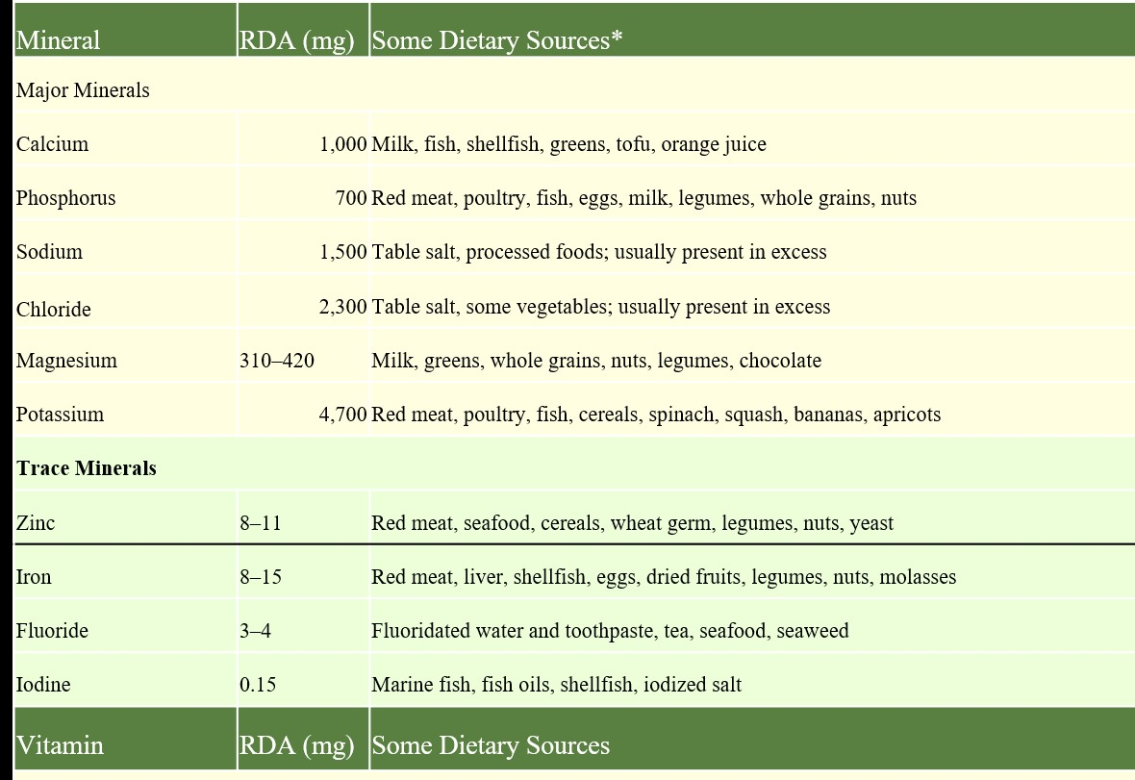
Table 18.2 Mineral and Vitamin Requirements and Sources

Slide 26
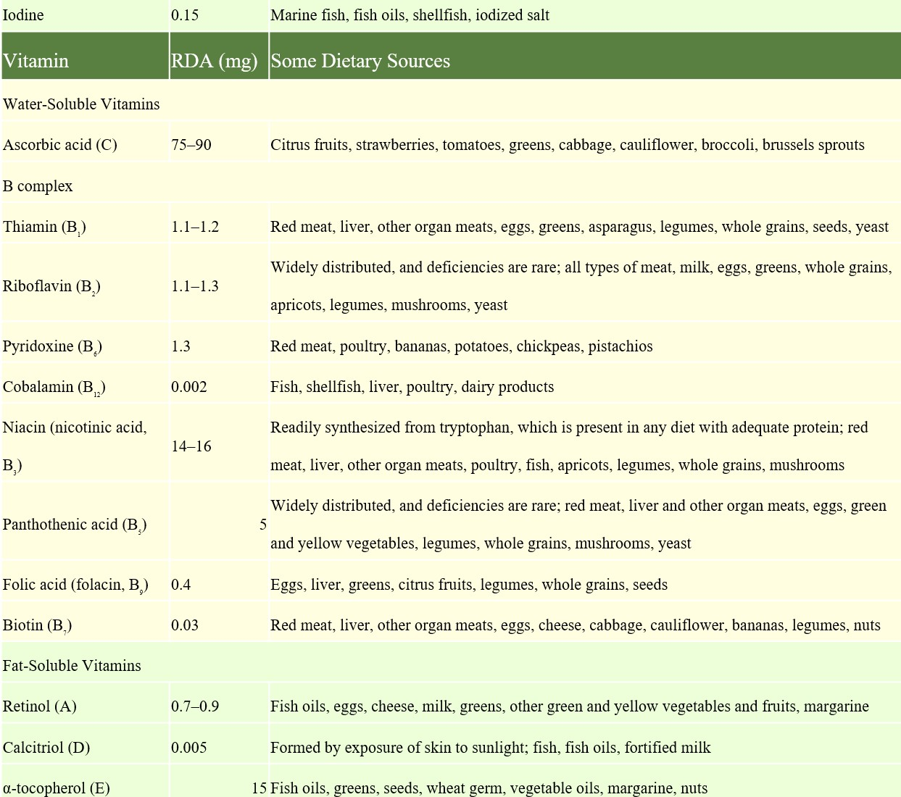

Slide 27
Vitamins are classified as water-soluble or fat-soluble.
Water-soluble vitamins are absorbed with water from the small intestine, dissolve freely in the body fluids, and are quickly excreted by the kidneys.
The water-soluble vitamins are ascorbic acid (vitamin C) and the B vitamins.
Ascorbic acid promotes hemoglobin synthesis, collagen synthesis, and sound connective tissue structure; it is an anti- oxidant that scavenges free radicals and possibly reduces the risk of cancer.
The B vitamins function as coenzymes—small organic molecules that assist enzymes by transferring electrons from one metabolic reaction to another, making it possible for enzymes to catalyze these reactions.

Slide 28
Fat-soluble vitamins are absorbed with dietary lipids.
They are more varied in function than water-soluble vitamins.
Vitamin A is a component of the visual pigments and promotes epithelial tissue maintenance.
Vitamin D promotes calcium absorption and bone mineralization.
Vitamin K is essential to blood clotting.
Vitamins A and E are antioxidants, like ascorbic acid.

Slide 29
Mini-Case #1 –

Slide 30
Mini-Case #1 –

Slide 31
Case Review
Questions
What are the four classes of macronutrients?
Why is fiber important in the diet, and why isn’t it considered a nutrient?
Why is fat more efficient than carbohydrates for energy storage?
Contrast the functions of VLDLs, LDLs, and HDLs. Explain why a high level of blood HDLs is desirable, but a high level of LDLs is undesirable.
Why do some proteins have more nutritional value than others?
Define the terms mineral and vitamin. Give several important examples of each.
Al-Farabi Kazakh National University
Higher School of Medicine

Slide 32
Carbohydrate Metabolism
Expected Learning Outcomes When you have completed this section, you should be able to
define metabolism, catabolism, and anabolism; 2. describe the basic purposes and products of glycolysis, 3. anaerobic fermentation, and aerobic respiration; 4. be able to trace the energy content of glucose through all these stages of metabolism, stating where the energy is contained by the end of each stage 5. describe the body’s modes of glycogen synthesis and break- down, and its synthesis of glucose from other noncarbohydrates.

Slide 33
Metabolism is the sum of all chemical changes in the body, and consists of two classes of reactions:
—energy-requiring synthesis reactions called anabolism,
—and energy-releasing breakdown reactions called catabolism.

Slide 34
Glucose Catabolism
Most dietary carbohydrate is burned as fuel within a few hours of absorption. Glucose is the major product of carbohydrate digestion, and provides us with quick energy when it is totally oxidized.
The function of this reaction is not to produce carbon dioxide and water but to transfer energy from glucose to ATP.
C₆H₁₂O₆ +6O₂ →6CO₂+6H₂O.

Slide 37
Glycolysis —extracts energy from glucose
Anaerobic Fermentation—In the absence of oxygen, a cell resorts to a one-step reaction called anaerobic fermentation, —to take an energy—2 ATP.
Aerobic Respiration — Most of our ATP is produced through oxidation of pyruvate in two principal steps:
∙ matrix reactions, so named because their controlling enzymes are in the fluid of the mitochondrial matrix, and
∙ membrane reactions, so named because their controlling enzymes are bound to the membranes of the mitochondrial cristae.

Slide 38
Glycogen Metabolism—if the body has an ample amount of ATP and there is still more glucose in the blood, it converts the glucose to other compounds better suited for energy storage—namely, glycogen and fat.
Glycogenesis, the synthesis of glycogen, is stimulated by insulin
Glycogenolysis, the hydrolysis of glycogen, is stimulated by glucagon and epinephrine between meals. It releases glucose when new glucose is not being absorbed from the intestine. The liver releases glucose into the blood, maintaining blood sugar levels between meals
Gluconeogenesis occurs when even the stored glycogen isn’t enough to meet our energy needs.
This is the conversion of noncarbohydrates such as glycerol and amino acids to glucose.

Slide 39
Table 18.3 Terminology Related to Glucose and Glycogen Metabolism
Anabolic (Synthesis) Reactions
Glycogenesis | The synthesis of glycogen by polymerizing glucose
Gluconeogenesis | The synthesis of glucose from noncarbohydrates such as glycerol and amino acids (from fat and protein)
Catabolic (Breakdown) Reactions
Glycogenolysis | The hydrolysis of glycogen to release glucose
Glycolysis | The splitting of glucose into two molecules of pyruvate in preparation for anaerobic fermentation or aerobic respiration

Slide 40
Lipid and Protein Metabolism
Expected Learning Outcomes
When you have completed this section, you should be able to
describe the process that uses the energy of triglycerides for synthesizing ATP, including the fates of the glycerol and fatty acid components;
describe the process of protein catabolism and why it generates nitrogenous wastes; and
identify several nondigestive functions of the liver.

Slide 41
Triglyceride synthesis is called lipogenesis.
Breaking down fat begins with lipolysis—splitting triglycerides into glycerol and fatty acids, if glucose supplies are low, fat is used for fuel.
Lipolysis is stimulated by epinephrine, norepinephrine, glucocorticoids, thyroid hormone, and growth hormone.
A typical fatty acid of 16 carbon atoms can yield 129 molecules of ATP—obviously a much richer source of energy than a glucose molecule.
In untreated diabetes, cells cannot take up glucose and therefore oxidize fats.
This leads to a telltale sweet odor on the breath from exhaled acetone (one of the ketone bodies); a diagnostic presence of ketone bodies in the urine; and often a ketoacidosis-induced coma and death.

Slide 42
Proteins
Amino acids are primarily used for protein synthesis—the process of building the thousands of different proteins necessary for cellular function and structure.
Each protein requires a specific combination of amino acids, assembled in proper order according to instructions contained in the DNA.
Amino acids can also be converted to glucose or fat or used directly as fuel.
Before they enter the citric acid cycle,
amino acids are deaminated—the amino group (—NH2) is removed
-and becomes ammonia (NH3), which is extremely toxic to cells.
-the liver quickly combines ammonia with carbon dioxide to produce a less toxic waste, urea,
-which is then excreted in the urine.

Slide 43
When a diseased liver cannot produce urea, ammonia accumulates in the blood and death from hepatic coma may ensue within a few days.

Slide 44
Table 18.4 Functions of the Liver
Carbohydrate Metabolism
Converts dietary fructose and galactose to glucose. Stabilizes blood glucose concentra- tion by storing excess glucose as glycogen (glycogenesis); releasing glucose from glyco- gen when needed (glycogenolysis); and synthesizing glucose from fats and amino acids (gluconeogenesis) when glucose demand exceeds glycogen reserves.
Lipid Metabolism
Carries out most of the body’s fat synthesis and synthesizes cholesterol and phospholip- ids; produces VLDLs to transport lipids to adipose tissue and other tissues for storage or use; and stores fat in its own cells. Carries out most oxidation of fatty acids; produces ketone bodies. Produces HDL shells, which pick up excess cholesterol from other tissues and return it to the liver; excretes the excess cholesterol in bile.
Protein and Amino Acid Metabolism
Carries out most deamination of amino acids. Converts ammonia to urea. Synthesizes nonessential amino acids.
Synthesis of Plasma Proteins
Synthesizes nearly all the proteins of blood plasma, including albumin, globulins, fibrino- gen, and several clotting factors.
Vitamin and Mineral Metabolism
Converts vitamin D₃ to calcidiol, a step in the synthesis of calcitriol; stores a 3- to 4-month supply of vitamin D. Stores a 10-month supply of vitamin A and enough vitamin B₁₂ to last for several years. Stores and releases iron as needed. Excretes excess calcium by way of the bile.
Digestion
Synthesizes bile acids and lecithin, which emulsify fat and promote its digestion.
Disposal of Drugs, Toxins, and Hormones
Detoxifies alcohol, antibiotics, and many other drugs. Degrades hormones, removing them from circulation.

Slide 45
Energy Balance and Appetite Regulation
Expected Learning Outcomes
When you have completed this section, you should be able to
explain the concept of energy balance;
name the hormones that regulate short- and long-term appetite and describe the effects of each;
name the appetite-stimulating and -inhibiting signals secreted in the hypothalamus, and describe their effects.

Slide 46
Appetite
Three peptides work over the short term—minutes to hours—first making one feel hungry and motivated to eat, then causing a feeling of satiety that signals an end to the meal.
Ghrelin is secreted by parietal cells in the stomach. It has been called the “hunger hormone” because it is a powerful appetite stimulator. Shortly after eating, ghrelin concentration in the blood drops.
Peptide YY (PYY) is secreted by cells in the ileum and colon that sense that food has arrived even as it enters the stomach.
— The primary effect of PYY is to signal satiety and terminate eating.
— Thus, ghrelin is one of the signals that begins a meal, and PYY is one of the
signals that ends it.
— PYY remains elevated well after a meal.
Cholecystokinin (CCK) is secreted by cells in the duodenum and jejunum.
— It stimulates the brain and produces an appetite-suppressing effect.
— Thus, it joins PYY as a signal to stop eating.

Slide 47
Other peptides regulate appetite, metabolic rate, and body weight over the longer term:
Leptin is secreted mainly by adipocytes throughout the body. Its level is proportional to fat stores, so this is the brain’s primary way of knowing how much body fat we have. Leptin inhibits fat deposition.∙
Insulin is secreted by pancreatic beta cells in response to eating. As we have seen, insulin lowers glucose levels in the blood by causing it to be transported into cells. In addition, like leptin, it signals the status of the body’s fat stores, but in contrast to leptin, insulin promotes fat deposition.

Slide 48
Important brain center for appetite regulation is the hypothalamus.
All five of the aforementioned peptides have receptors in the hypothalamus.
One of these is neuropeptide Y (NPY), a potent appetite stimulant.
Ghrelin stimulates NPY secretion, whereas insulin, PYY, and leptin inhibit it.
Leptin stimulates melanocortin secretion and inhibits the secretion of appetite stimulants called endocannabinoids.
The hypothalamus also secretes melanocortin, which inhibits eating.
Mild hunger contractions begin soon after the stomach is emptied and increase in intensity over a period of hours.

Slide 50
Body Heat and Thermoregulation
Expected Learning Outcomes
When you have completed this section, you should be able to
state the normal ranges of human core and shell temperature;
identify the principal sources of body heat;
define and contrast three modes of heat loss and their relative contributions to total heat loss;
describe how the hypothalamus monitors body tempera- ture and how the heat-losing and heat-promoting centers work; and
name and describe the pathological states of excessively high and low body temperatures.

Slide 51
Body Temperature
Body temperature fluctuates about 1°C (1.8°F) in a 24-hour cycle.
Shell temperature is the cooler temperature closer to the surface, especially skin and oral temperature.
Adult oral temperature is typically 36.6° to 37.0°C (97.9°–98.6°F) but may be as high as 40°C (104°F) during hard exercise.
Rectal temperature (as the temperature of organs in the cranial, thoracic, and abdominal cavities):
It is typically 37.2° to 37.6°C (99.0°–99.7°F) but may be as high as 39°C (102.2°F) during vigorous exercise such as running for prolonged periods.

Slide 52
Heat Production and Loss
Most body heat comes from metabolic reactions related to nutrient oxidation and ATP use.
At rest, most heat is generated by the brain, heart, liver, and endocrine glands. Skeletal muscles contribute about 20% to 30% of the total resting heat.
The body loses heat in four ways: radiation, conduction, convection, and evaporation.

Slide 53
Thermoregulation
Thermoregulation is achieved through several negative feedback loops.
The hypothalamus monitors the temperature of the blood and receives signals from nerve endings (thermoreceptors) in the skin.
In turn, its heat-sensing neurons send signals to hypothalamic nuclei called the heat-losing and heat-promoting centers.
If this fails to restore or maintain normal core temperature, the body resorts to shivering.

Slide 54
In a cold environment, the heat-promoting center of the hypothalamus activates mechanisms to conserve body heat or generate more.
By way of the sympathetic nervous system, it causes cutaneous vasoconstriction.
This retains warm blood deeper in the body and less heat is lost through the skin, If this fails to restore or maintain normal core temperature, the body resorts to shivering.
Muscle contraction causes heat to be released when ATP is produced.

Slide 55
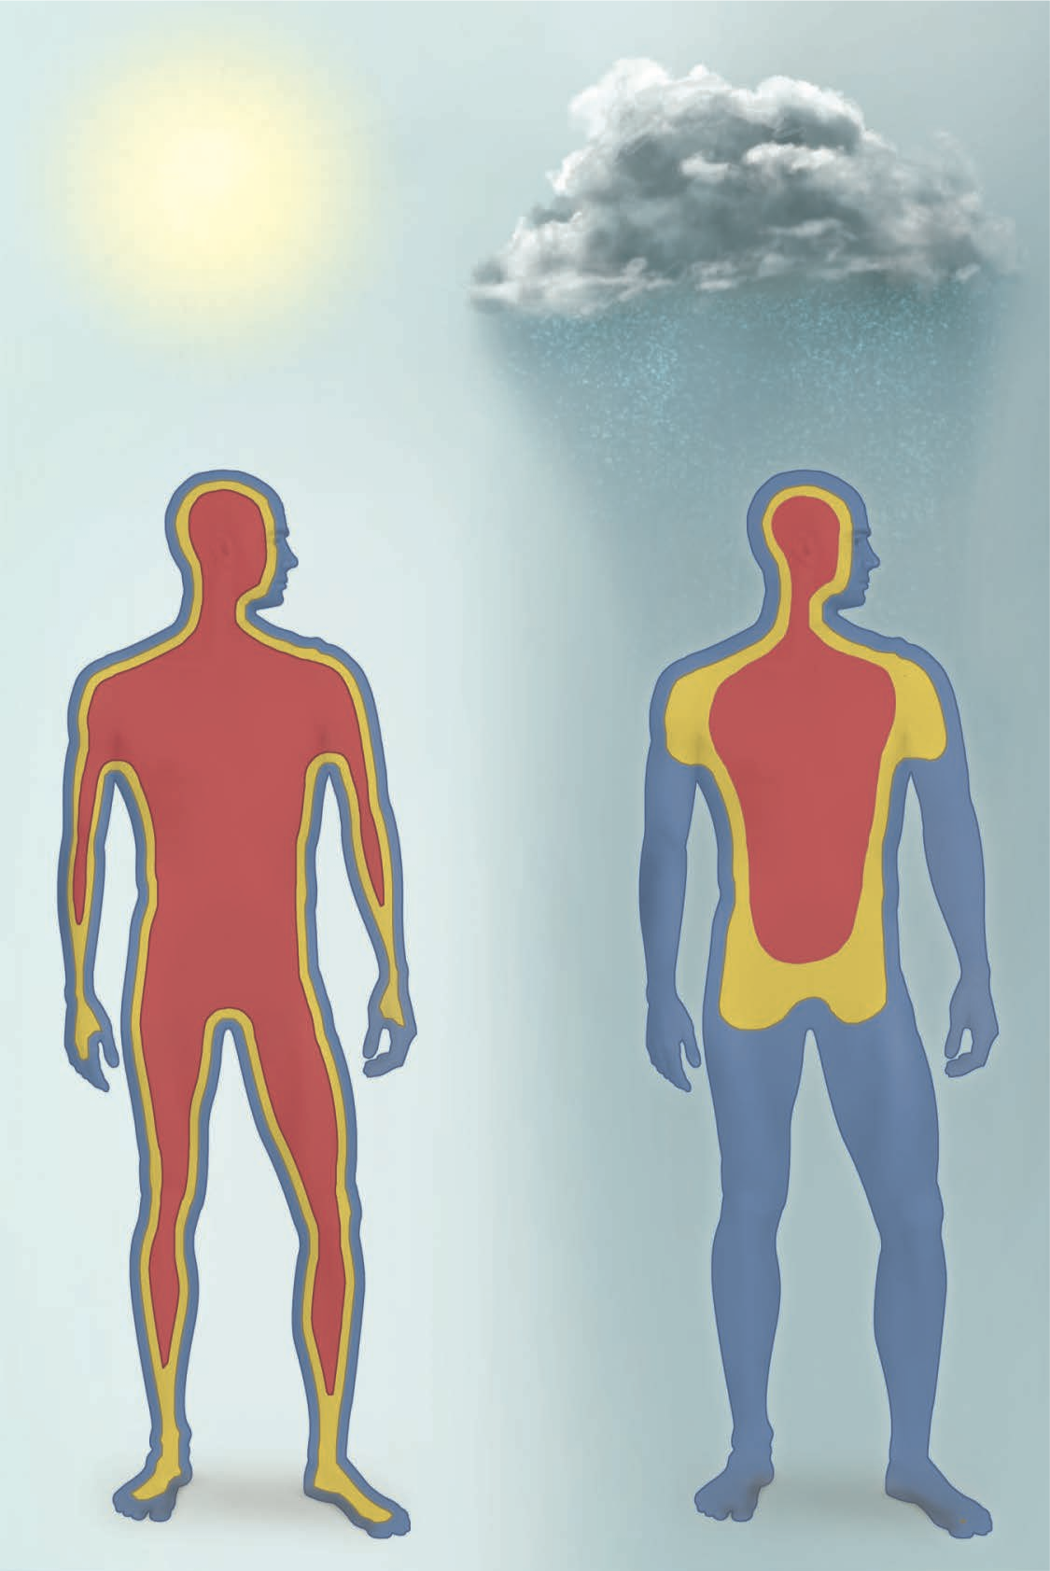

Slide 56
HYPOTHERMIA AND FROSTBITE
Hypothermia occurs when the body can’t generate heat as quickly as it is lost to the environment. All of us have experienced a drop in body temperature in response to cold weather; a decrease in body temperature of 1° to 2°C (1.8° to 3.6°F) leads to shivering, goose bumps, and numb hands. Exposure to extreme cold, however, can lead to hypothermia, when body temperature drops to a level where the hypothalamus can no longer produce an adequate response, and cellular metabolic processes slow to the point of disrupting normal body function.

Slide 57
Mountain climbers exposed to low temperatures and windy conditions must be careful to notice the symptoms of hypothermia in themselves and their companions—poor muscle coordination, difficulty speaking, blue fingertips and lips, and impaired cognitive ability.
Drinking warm liquids, getting to shelter, and warming with blankets or by sharing body heat are essential to prevent a further slide toward nervous system depression and possible death.

Slide 58
Another concern is frostbite, which results from exposure of body surfaces to temperatures low enough to freeze tissues.
It occurs most often in regions of high surface area and exposure—fingers and toes, earlobes, and the tip of the nose. If intracellular water freezes, the ice crystals expand and rupture cells, and tissues die. In severe cases, gangrene follows thawing and the affected areas must be amputated.

Slide 59
Disturbances of Thermoregulation
Either excessively low body temperature, called hypothermia, or excessively high body temperature, called hyperthermia, can disrupt metabolism to the point of death. Hypothermia can result from exposure to cold weather or immersion in icy water (Clinical Application 18.2). If the core temperature falls below 33°C (91°F), the metabolic rate drops so low that heat production can’t keep pace with heat loss, and the temperature falls even more. Death from cardiac fibrillation may occur below 32°C (90°F), but some people survive body temperatures as low as 29°C (84°F) in a state of suspended animation. A body temperature below 24°C (75°F) is usually fatal.

Slide 60
Hyperthermia is characterized by heat cramps, heat exhaustion, and heatstroke.
Heat cramps are painful muscle spasms that result from excessive electrolyte loss in the sweat. They occur especially when a person begins to relax after strenuous exertion and heavy sweating.
Heat exhaustion results from more severe water and electrolyte loss and is characterized by low blood pressure, dizziness, vomiting, and sometimes fainting.
Heatstroke (sunstroke) occurs when the core body tempera- ture is over 40°C (104°F); the skin is hot and dry; and the subject exhibits nervous system dysfunctions such as delirium, convulsions, or coma. It is also accompanied by tachycardia, hyperventilation, inflammation, and multiorgan dysfunction; it is often fatal.

